Slide 1
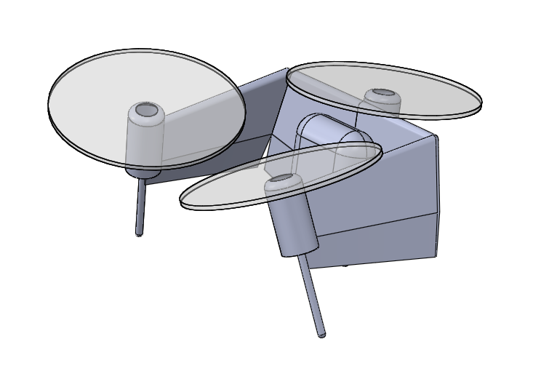
Three non-colinear thrust lines for maneuverability

